Slide 1
Transitioning from Low-Income Growth to High-Income Growth
David Bulman
Maya Eden
Ha Nguyen
World Bank Group
Development Research Group
Macroeconomics and Growth Team
November 2014
Presenter: Nan Zhi

Slide 2
Questions?
Is there a middle income trap?
If there is a middle income trap, what causes it?

Slide 3
Introduction
“Middle Income Trap”: If countries struggle to transition from growth strategies that are effective at low income levels to growth strategies that are effective at high income levels, they may stagnate at some middle income level.
For middle income countries: existing policies that facilitated earlier growth from low income to middle income might not work as well for transitioning from middle income to high income.
Seek a set of policies that can help them achieve strong and sustained growth and eventually help them join high income countries.
This paper provides a set of stylized facts about middle income countries and about fundamentals that might facilitate the transition from middle to high income.

Slide 4
Basic Facts on Countries’ Income Dynamics
This paper focus on relative income, which is highly persistent.
Low income: less than or equal to 10%
Middle income: between 10%-50%
High income: above 50%
of U.S. PPP GDP per capita
Against the existence of a middle income trap:
Escapees: middle income countries that successfully transitioned to high income countries
Non-escapees: middle income countries that have yet to transition
The list of escapees includes Greece; Hong Kong SAR, China; Ireland; Japan; Puerto Rico; the Republic of Korea; Seychelles; Singapore; Spain; and Taiwan, China(During 1960-2009). 10 of 58 are escapees.

Slide 5
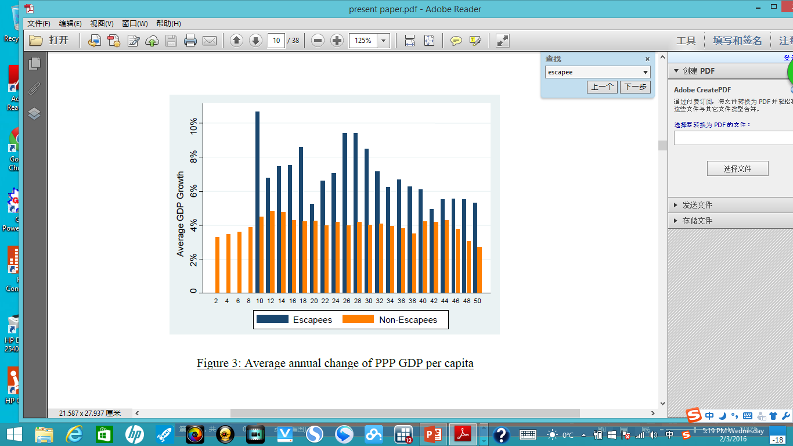
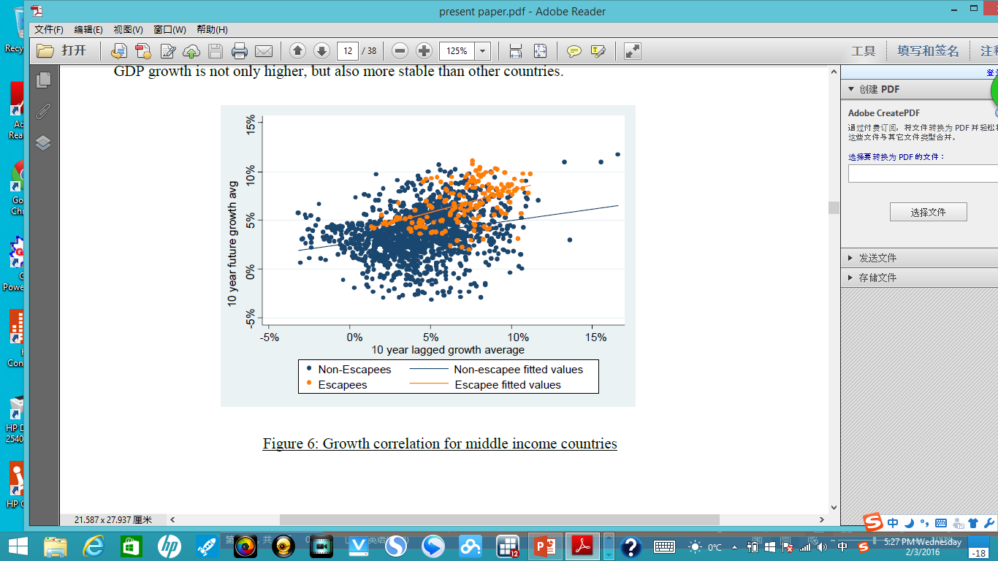
Escapees as a whole grow strongly towards high income and they do not exhibit significant signs of slowing down, which presents evidence against the existence of a middle income trap that causes growth to stagnate at a particular income level.
Non-escapees on average have slower growth at all levels of income
The x axis presents average growth over t-10 through t-1, while the y axis presents average growth from t+1 through t+10, for all available years. The correlation coefficient for middle income escapees is 0.47, while the correlation coefficient for middle income non-escapees is 0.25. Escapees’ GDP growth is not only higher, but also more stable than other countries.

Slide 6
Comparing Fundamentals of Escapees and Non-escapees
Total-Factor Productivity (TFP) growth and GDP per capita growth
Education, research and innovation
Economic structure (transformation from agriculture to industry)
Openness (exports sector)
Macroeconomic conditions (inflation)
inequality and demographic

Slide 7
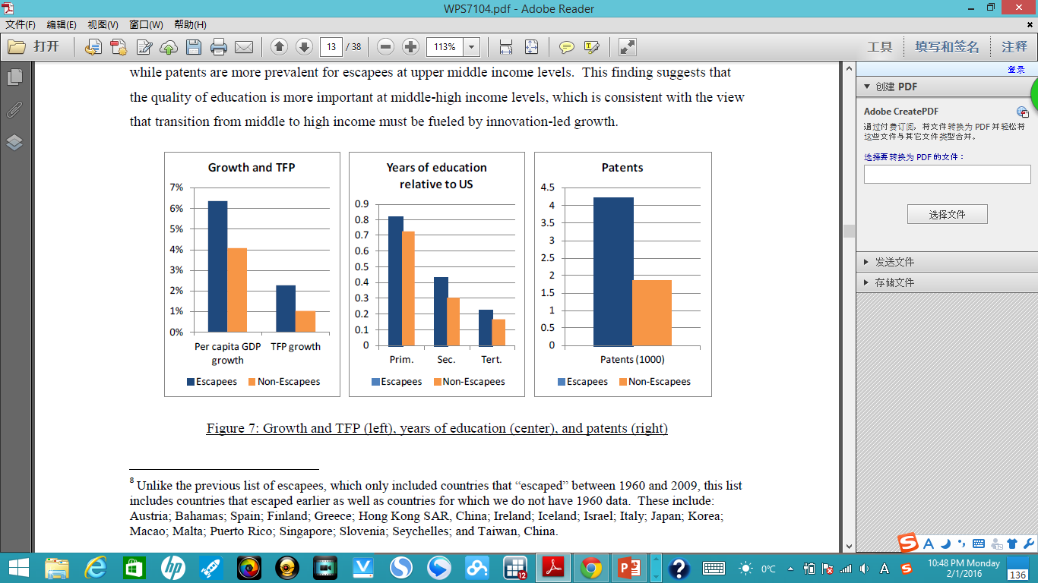
Escapees have higher growth as well as higher TFP growth.
Escapees exhibit higher levels of primary, secondary, and tertiary education
And are also clearly differentiated from non-escapees by the number of patents they generate.

Slide 8
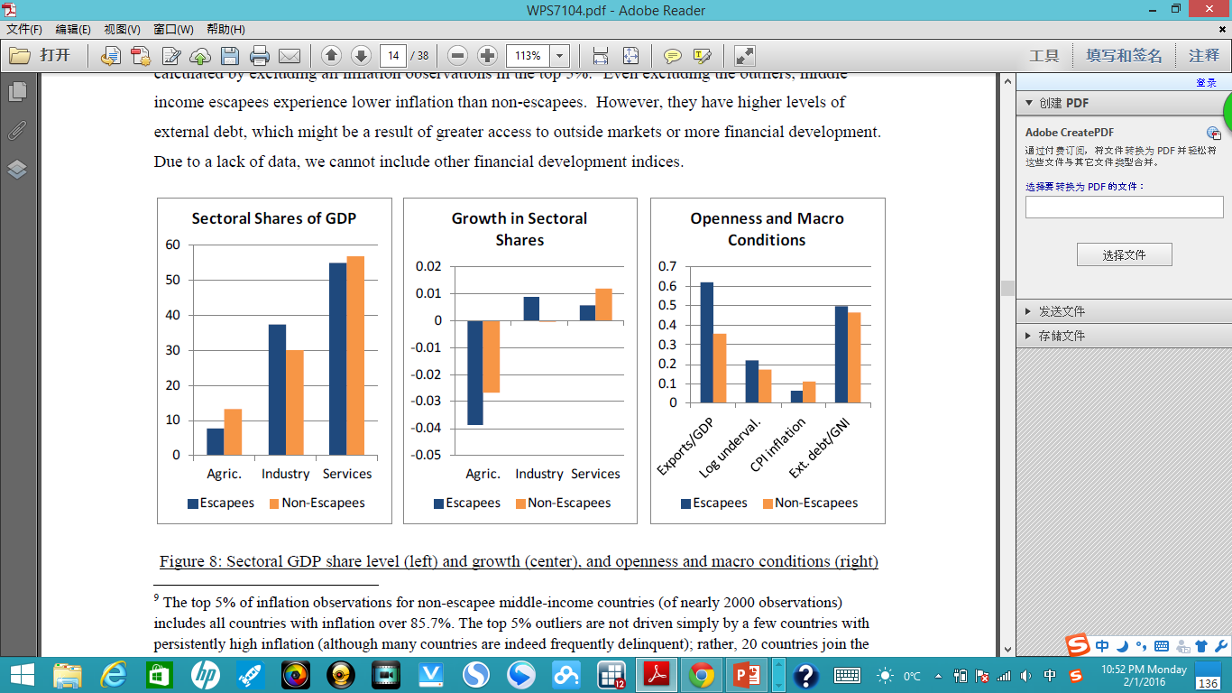
Escapees tend to have larger industry sectors and smaller agriculture and service sectors, and they also have higher growth in industry and lower growth in agriculture and services. This transition is particularly prevalent at lower-middle income levels
Escapees are in general more open and have better macroeconomic conditions. They are significantly more export-oriented and have more undervalued currencies

Slide 9
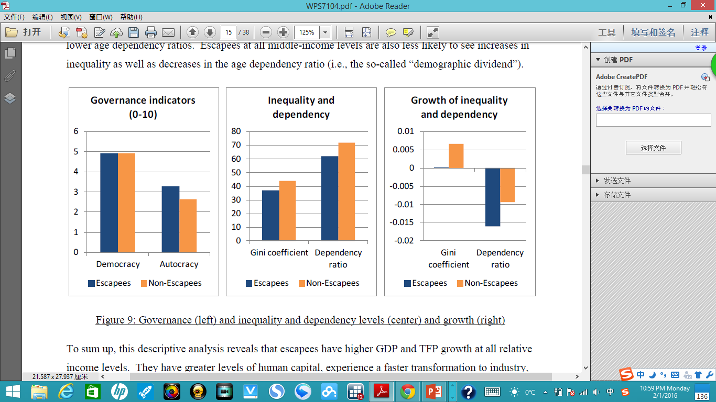
Escapees and non-escapees have similar levels of democracy.
Escapees have greater equality and lower age dependency ratios.
Escapees at all middle-income levels are also less likely to see increases in inequality as well as decreases in the age dependency ratio.

Slide 10
Alternative Analysis on Fundamentals
Previous slides shows that fasting-growing countries have better fundamentals than slow-growing countries.
Alternative analysis looks at growth performance based on fundamentals.
Separating results for lower middle income countries (10-30% of U.S. income) and upper middle income countries (30-50% of U.S. income) in order to see how growth determinants differ across the middle income spectrum.

Slide 11
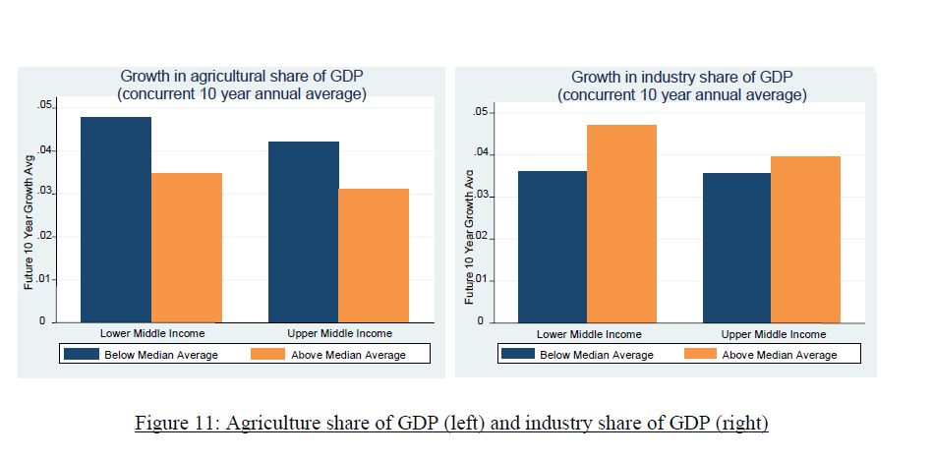
The blue bars represent the average future 10-year average growth rates for all country/year observations in which the agricultural share of GDP is lower than the median value for all lower/upper middle income countries in that particular year.
Medians are calculated on an annual basis for lower and upper middle income countries separately.
Lower-middle income countries experience larger declines in the agricultural share and increases in the industry share grow much faster on average.

Slide 12
Human Capital:
lower middle income countries benefit from more tertiary education
lower middle income countries with above-median patents grow faster, upper middle income countries grow slower. (This contrasts with previous chart since that result was driven by the patent performance of Korea and Japan)
Openness:
For both lower and upper middle income countries, export-orientation is associated with higher growth and undervaluation is associated with lower growth. These trends are particularly strong for upper middle income countries.
Governance and politics:
Similar to the previous results, Democracy has little if any predicted effect on growth for either lower or upper middle income countries.
Inequality and demographics:
Similar to the previous results, lower dependency ratios result in faster growth for both level.
In terms of inequality, larger increases in the Gini coefficient are associated with slower growth, with a particularly pronounced effect for upper middle income countries.

Slide 13
Regressions
Dependent variable | Average growth of annual PPP GDP per capita
Independent variables | Gini coefficient (-)
 | Fertility Rate
 | Age Dependency (-)
 | Agriculture share of GDP (-)
 | Tertiary education level relative to the U.S. (+)
 | Inflation (-)
 | Polity score
 | Trade share of GDP (+)
 | Log of undervaluation (-)

Slide 14
Data
Several issues exist with cross-country growth regressions (Esterly et al, 1993)
Baseline data used for growth accounting exercise, including per capita GDP, employment, and investment, come from the Penn World Tables Version 7.0 (Heston, et al., 2011).
Inequality data on Gini coefficients comes from Milanovic (2005).
Governance indicators come from the Polity IV database.
Undervaluation is calculated following Rodrik (2008).
Other data comes from the World Bank World Development Indicators dataset.

Slide 15
Regressions
The baseline regression pools low and middle income countries and looks at nine variables and their interaction terms with the middle income dummy, along with controls for lagged income growth and income relative to the United States.
In order to identify which factors matter for poor countries but not for middle income countries.

Slide 16
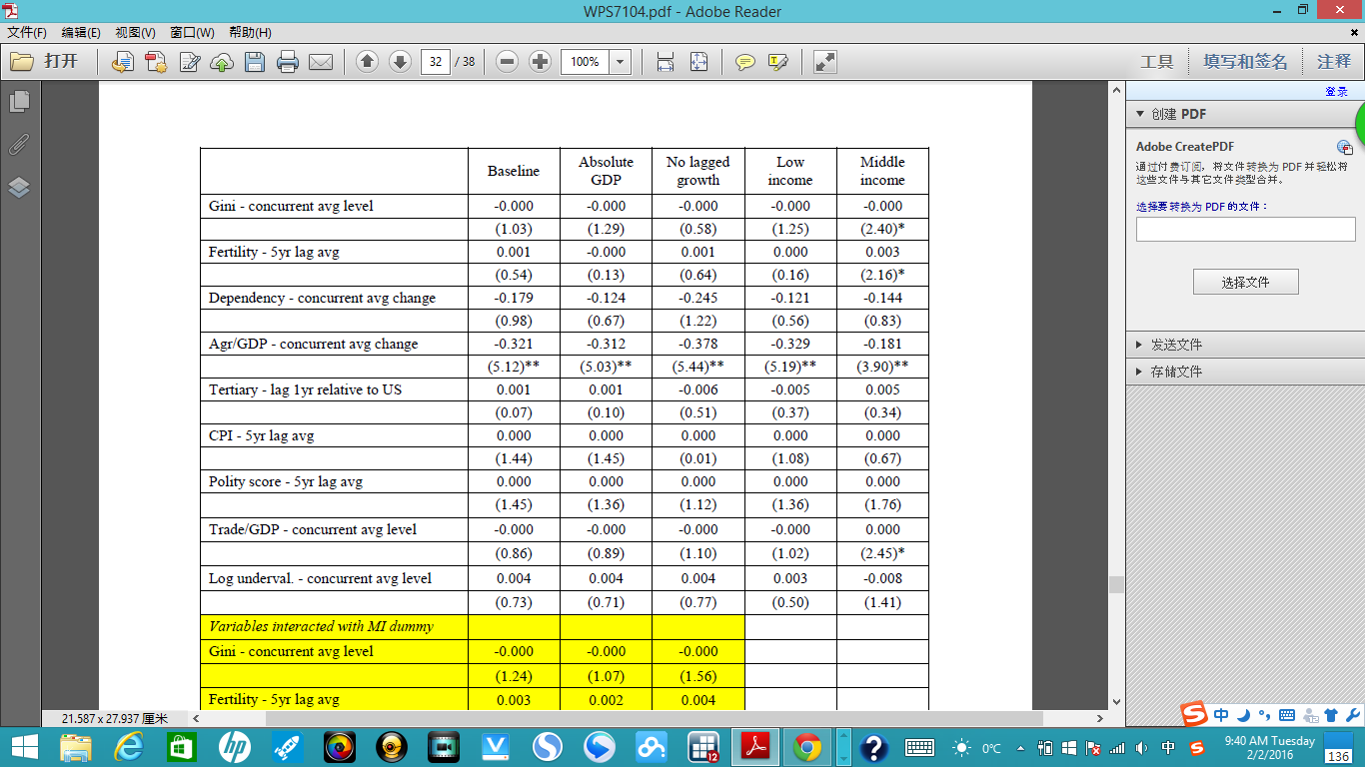
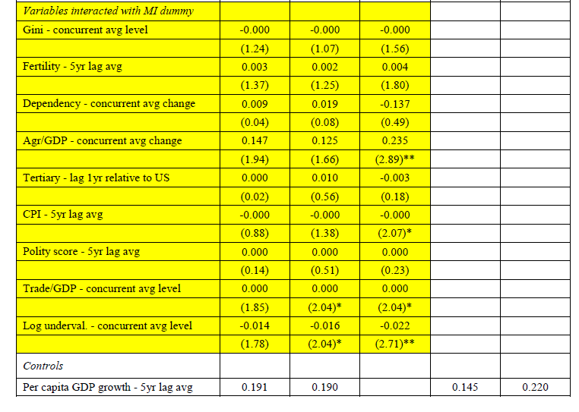
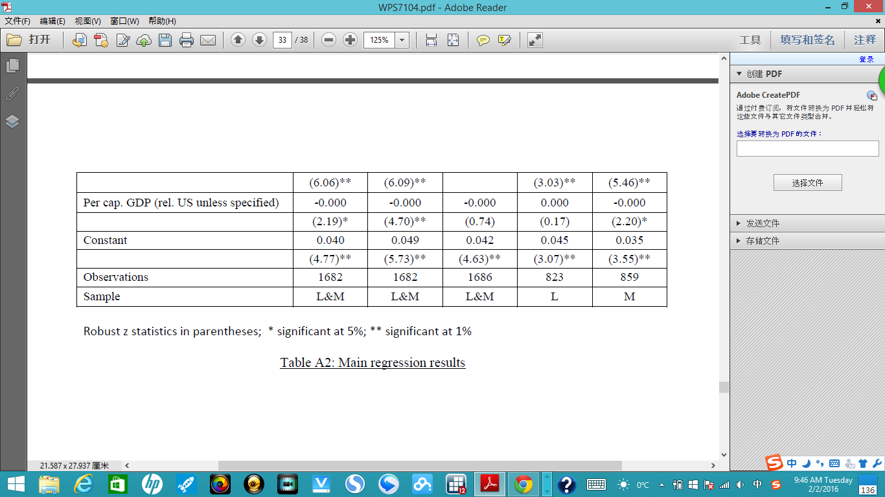

Slide 17
Results
Lagged five year growth is significant in all specifications.
The following factors are significant for growth of middle income countries: Gini coefficient, fertility rate, decline in the agricultural share of GDP, the trade share of GDP.
The coefficient on the change in the agricultural share of GDP is significantly negative, suggesting that declining agriculture shares of GDP are important for growth.
The lagged level of years of tertiary education is insignificant in the pooled sample, as is the interaction term.

Slide 18
Conclusion
Is there a middle income trap?
Countries that grow fast continue to grow fast, and they do not get “stuck” at any particular middle income level. However, this finding does not mean that there are no countries that are trapped at a middle income level. Middle income countries that did not “escape” remain stagnant with low growth at all levels of relative income. Transitioning from middle income to high income is hard.
Different fundamental of escapees and non-escapees: escapees have higher growth at all relative income levels, higher TFP growth, and experience a faster transformation towards industry. They have better macroeconomic management, greater income equality and more export-oriented.
Regressions suggests that growth in middle income countries is positively associated with industrialization, openness, and equality. However, there is no clear associations between education and innovation to growth in middle and low income countries.

